Slide 1
Summary of SEM sessions
Gottfrid Olsson
2024-07-08

Slide 2
Contents
NOTE: for more images and information see:
The experimental log
The “Sample table” excel
The SEM Powerpoints
Overview
SEM sessions
Short sample description
SEM images per sample with short note
Summary
Polishing
Deposited Li
SEM image acquisition and analysis
Reproducibility
Next steps
Ideas for improving reproducibility
Roadmap for one possible path forward

Slide 3
Overview
Measured 5 times in SEM
20 samples (S06, S07, S08, S09, S12, S13, S14, S15, S16, S17, S18, S19, S20, S21, S22, S23, S26, S27, S28, S29)
For a full description of the samples, see the “Sample table” Excel.

Slide 4
SEM-01
(I’ll write this as:
S06_t1800_C0001
S07_t1800_C0003
S08_t1800_C0010
S09_t1800_C0030 )
S06, S07, S08, S09
Passivation at 0.010 V hold for 1800 s
Deposition 1, 3, 10, and 30 μAh/cm2, respectively
Why measure? To investigate…
how low values of C can be measured in the SEM for the I-cell for good passivation
how even the deposition is in the I-cell

Slide 5
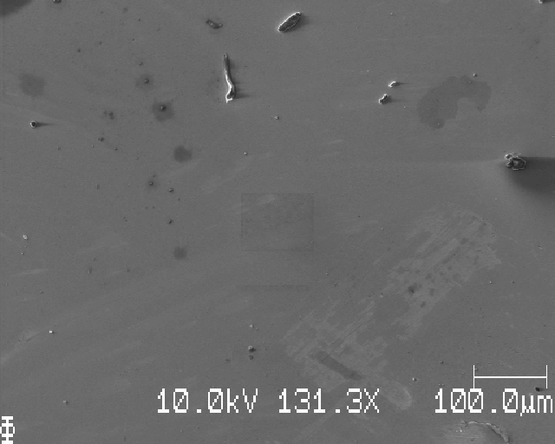
S06_t1800_C0001
No Li observed

Slide 6
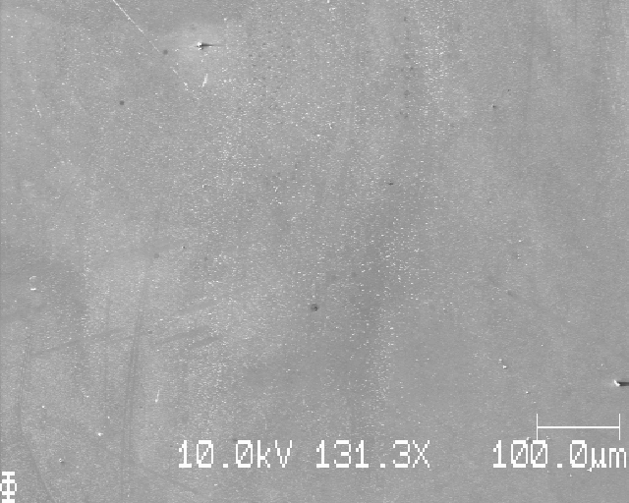
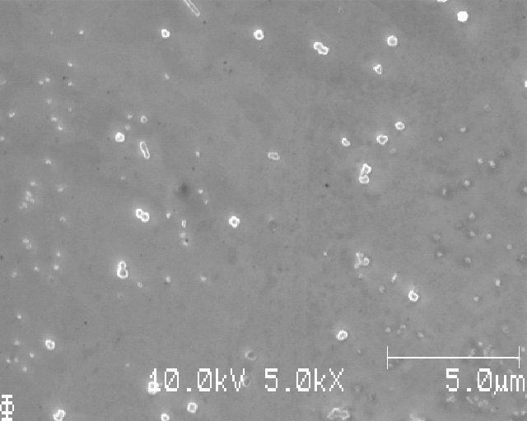
S07_t1800_C0003
Clear Li deposition at some points

Slide 7
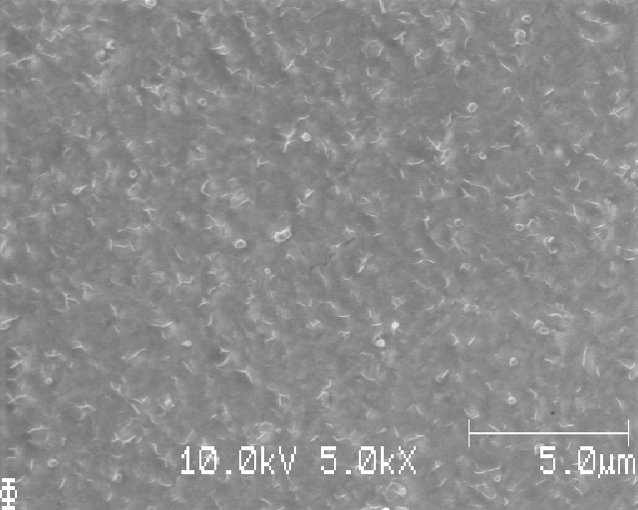
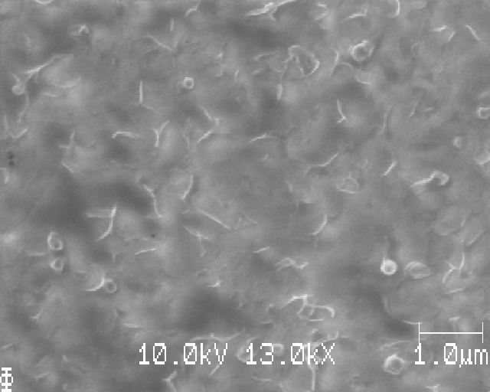
S07_t1800_C0003
“Worms” observed

Slide 8
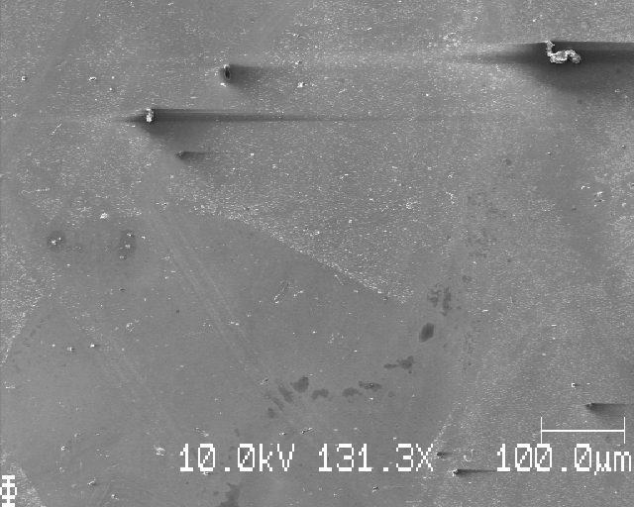
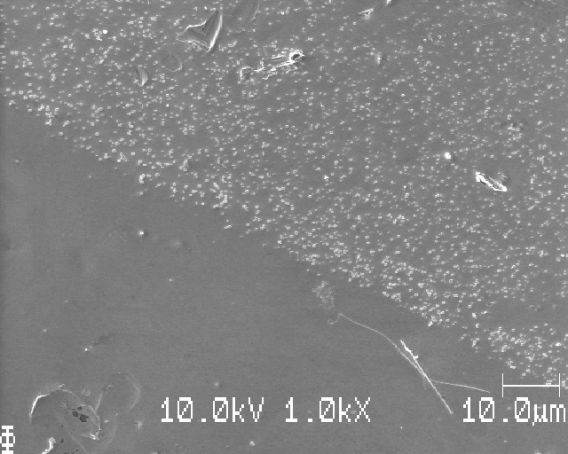
S08_t1800_C0010
Clear Li deposition, uneven at places

Slide 9
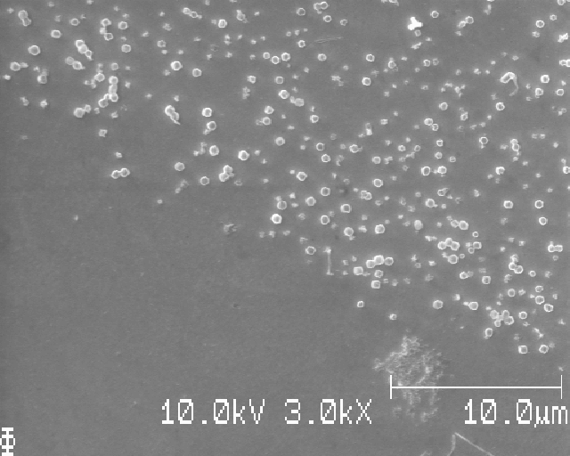
S08_t1800_C0010
Clear Li deposition, uneven at places

Slide 10
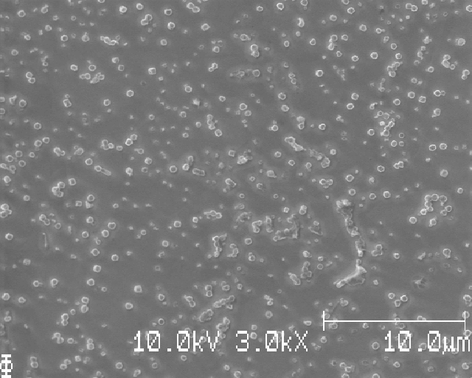
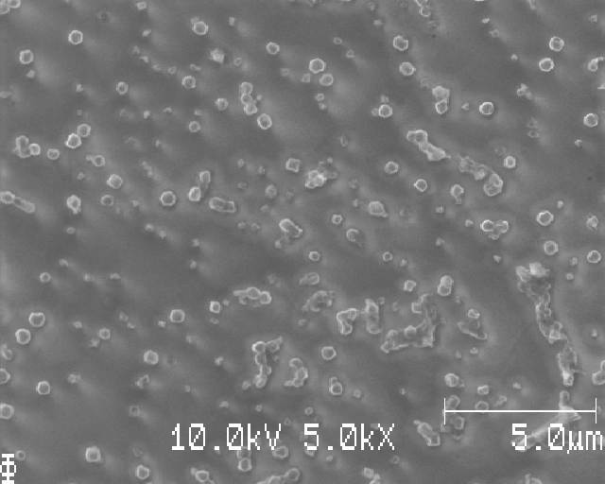
S08_t1800_C0010
'Halos' around Li particles

Slide 11
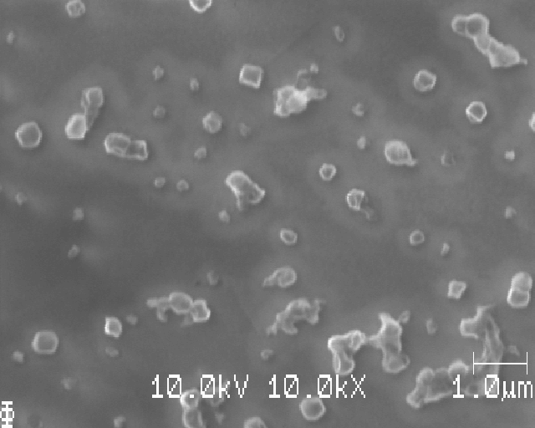
S08_t1800_C0010
'Halos' around Li particles

Slide 12
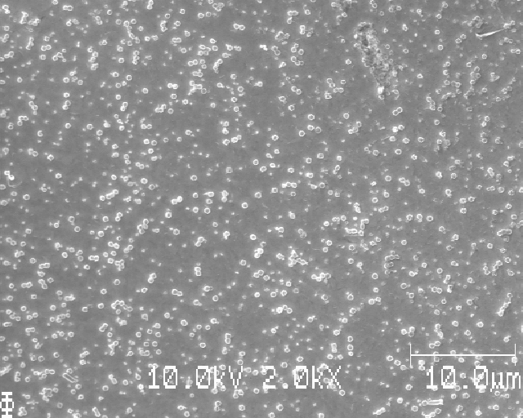
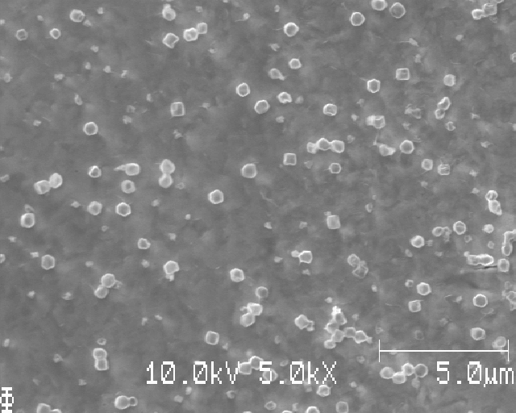
S08_t1800_C0010
Clear Li deposition with crystalline particles

Slide 13
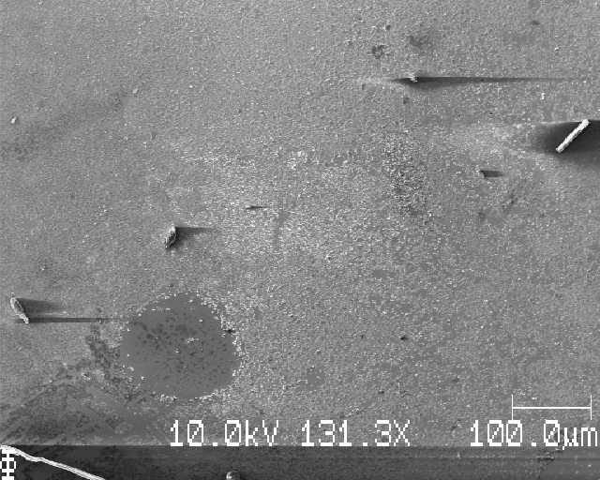
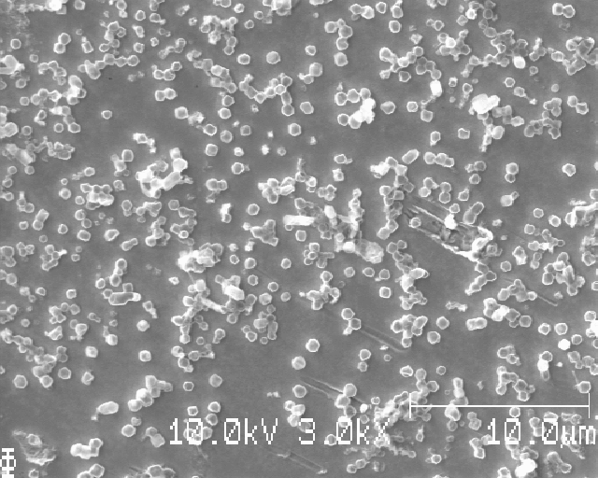
S09_t1800_C0030
A lot of 'worms' observed, only some areas of Li particles
Bad washing in some places

Slide 14
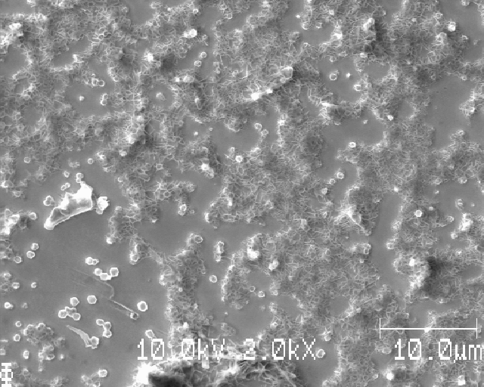
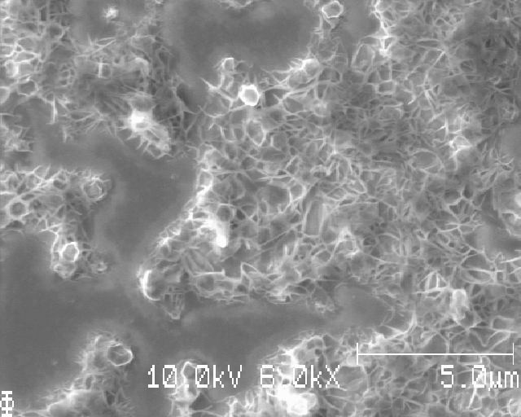
S09_t1800_C0030
A lot of 'worms' observed, only some areas of Li particles

Slide 15
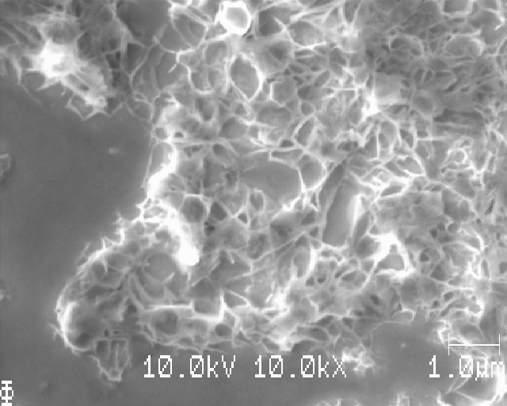
S09_t1800_C0030
A lot of 'worms' observed, only some areas of Li particles

Slide 16
Electropolishing = much more smooth Cu surface
Almost no grinding-marks visible after electropolishing

Slide 17
SEM-02
S12_t0012_C0010
S13_t0060_C0010
S14_t1800_C0030
S15_t1800_C0030
Why measure? To investigate…
Different passivation for same deposition C0010 (t0012, t0060, and t1800 including S08)
Repeat of previous measurements (S14, S15)
Test acquisition method of taking SEM images in a grid

Slide 18
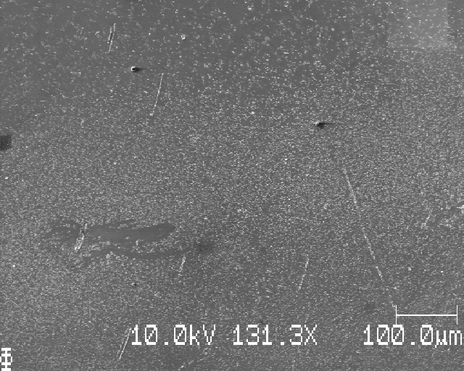
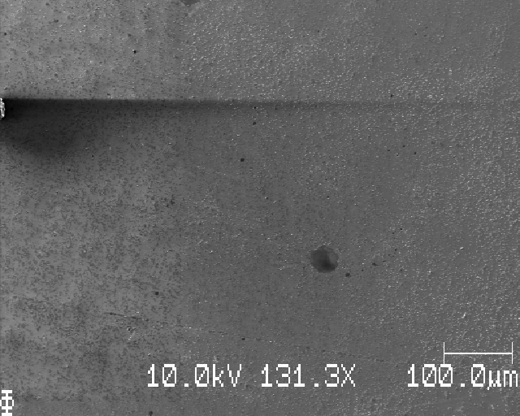
S12_t0012_C0010
Uneven Li deposition, globally and locally.
Few places had good Li deposition with crystalline particles, most had not

Slide 19
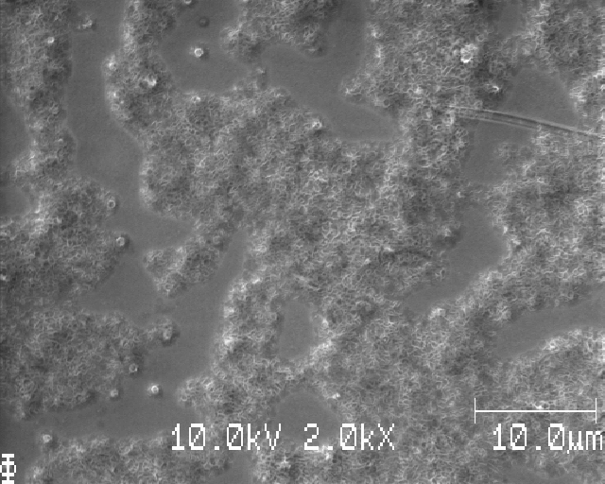
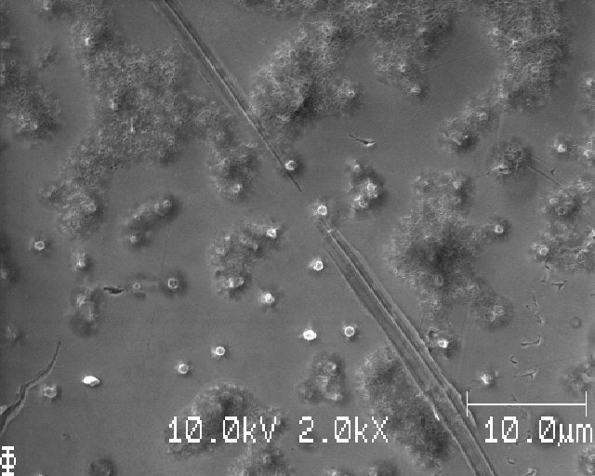
S12_t0012_C0010
Areas with 'worms' and Li nuclei, some areas with only nuclei.

Slide 20
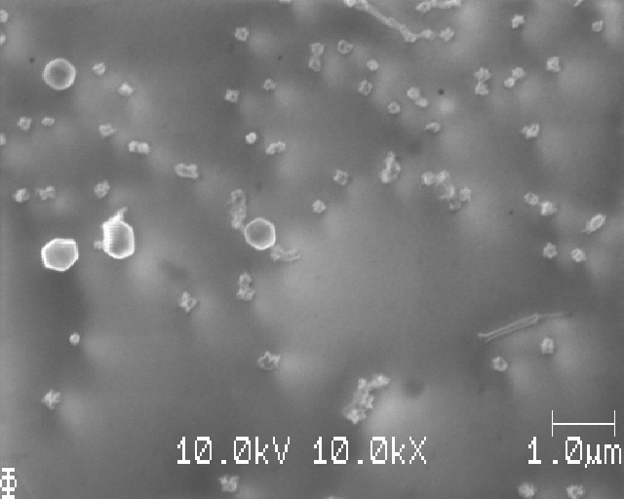
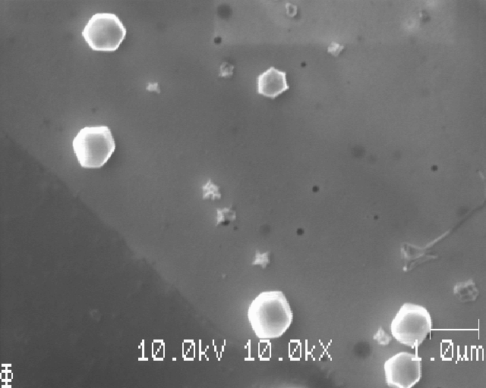
S13_t0060_C0010
Various sizes of Li nuclei (looks corroded)

Slide 21
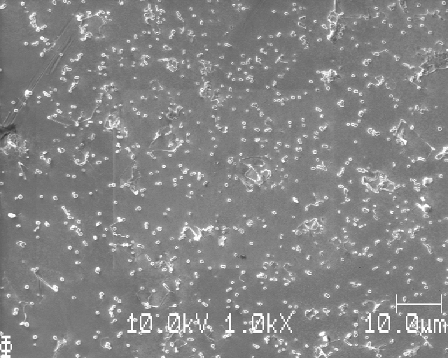
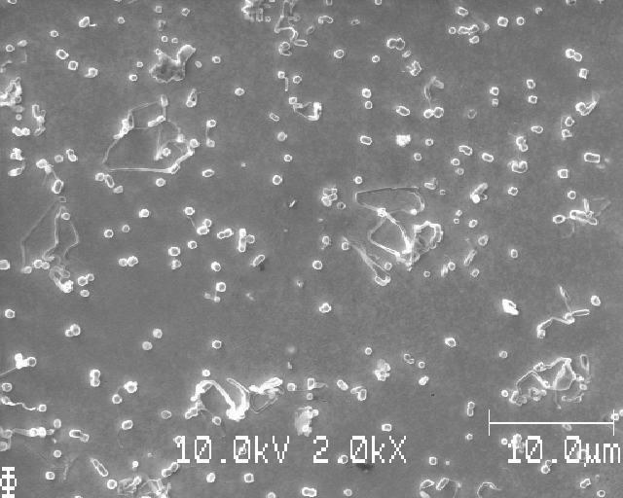
S13_t0060_C0010
Needle-like structures observed

Slide 22
S13_t0060_C0010
Uneven Li deposition
Grid-sampling tested: seems to work good

Slide 23
S14_t1800_C0030
No 'worms' observed
Ring-like deposition (like the coin cell)

Slide 24
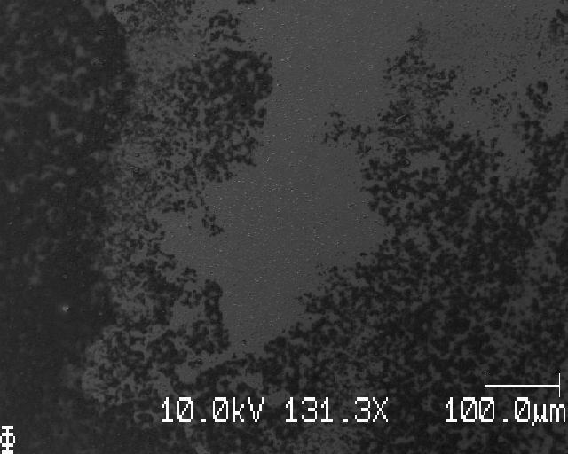
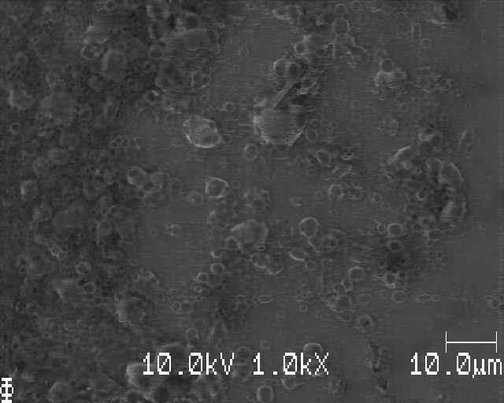
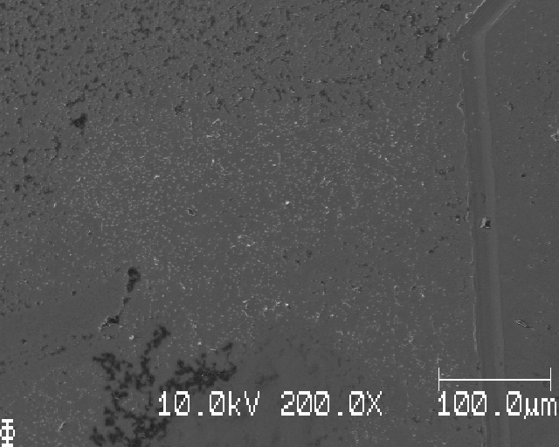
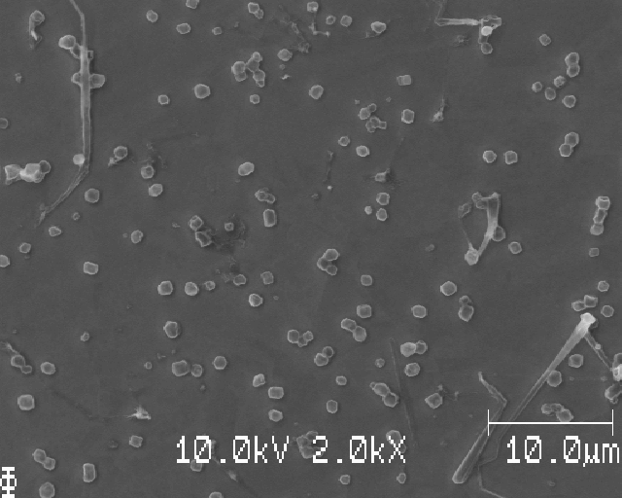
S15_t1800_C0030
Bad, and uneven, washing.

Slide 25
SEM-03
S16_t1800_C0010
S17_t1800_C0010
S18_t1800_C0010
S19_t1800_C0010
Why measure? To investigate…
Reproducibility after having done changes to the method, primarily more rigorous washing

Slide 26
S16_t1800_C0010
Li deposition more even, but some areas have no Li
Washing looks better (meaning no black stuff on the surface)
4x4 grid sampling seems to work well (next 2 slides)
But the Li deposition is uneven and bad wash in some places

Slide 27
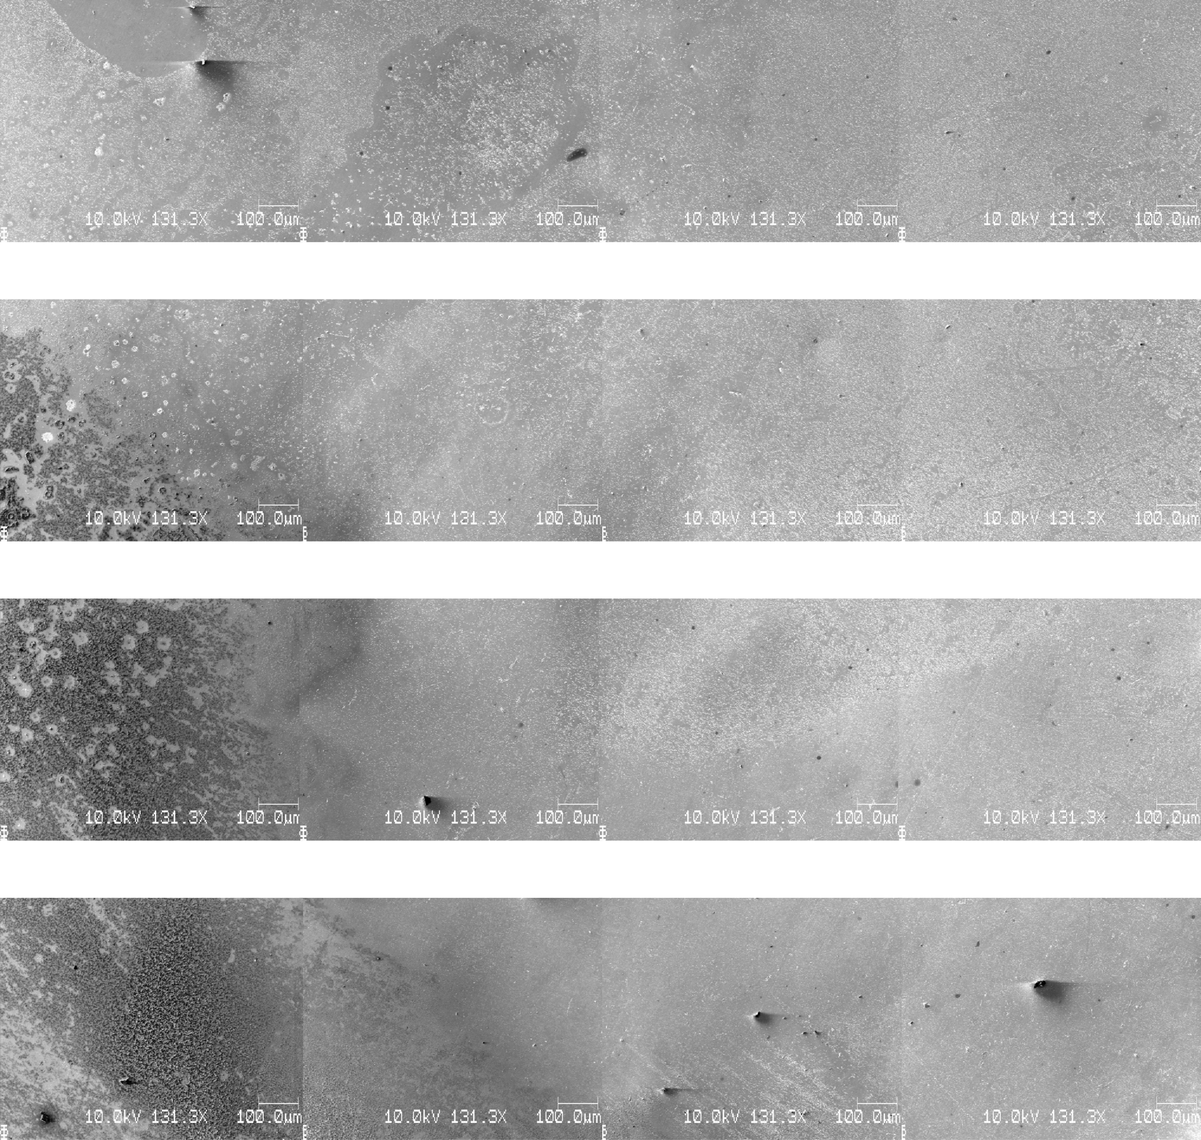
S16_t1800_C0010
dx=dy=750mu

Slide 28
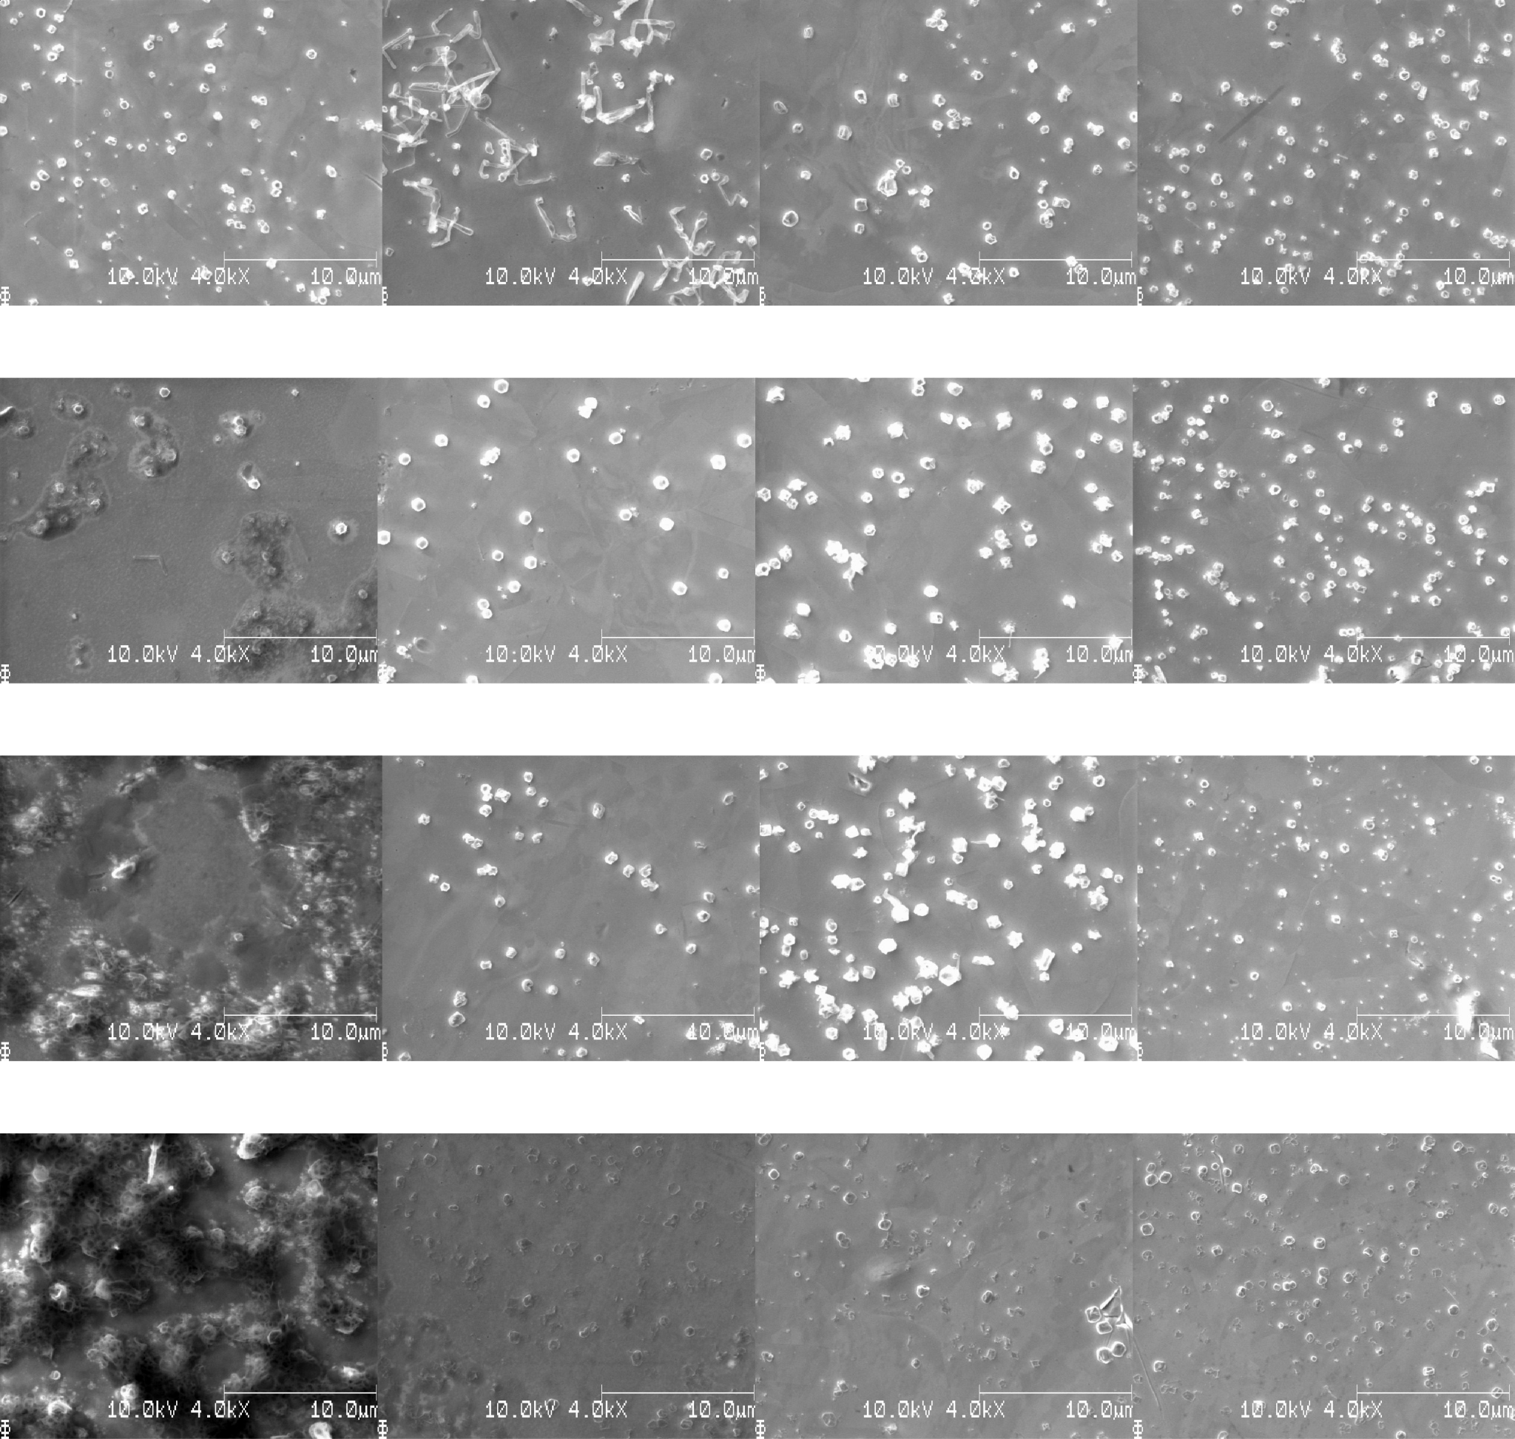
S16_t1800_C0010
dx=dy=750mu
Zoom

Slide 29
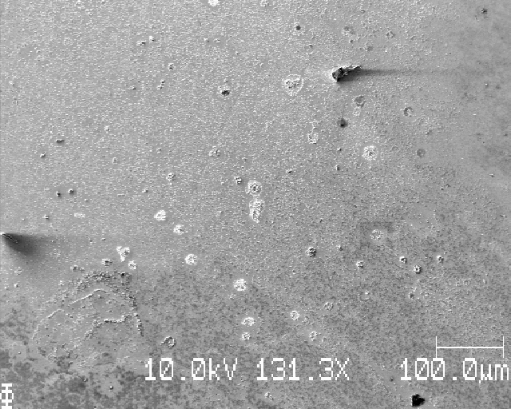
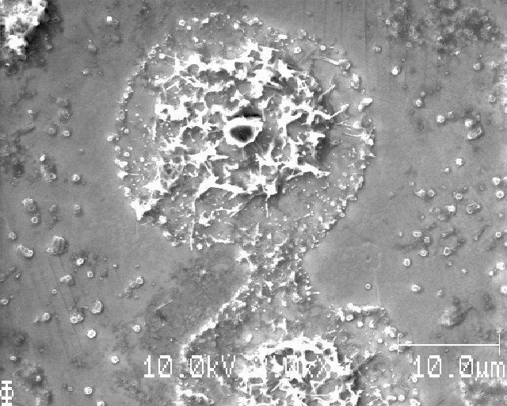
S16_t1800_C0010
Unusual Li(?) structure

Slide 30
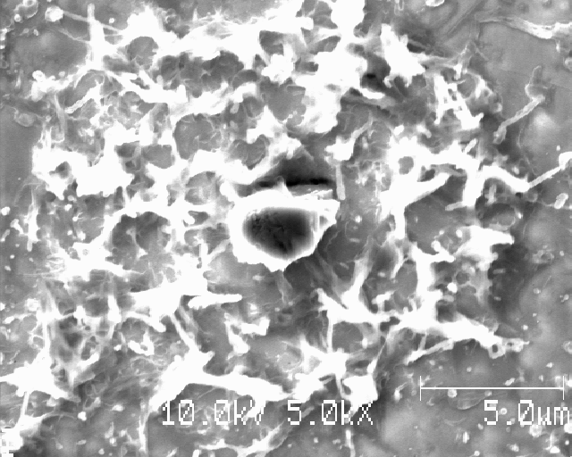
S16_t1800_C0010
Unusual Li(?) structure

Slide 31
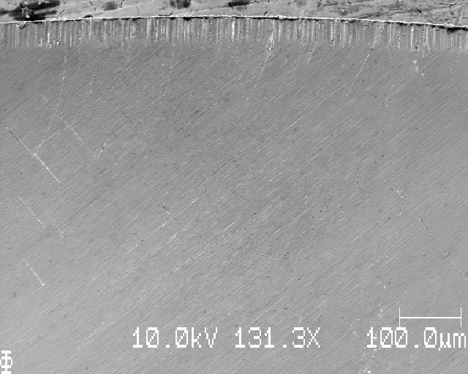
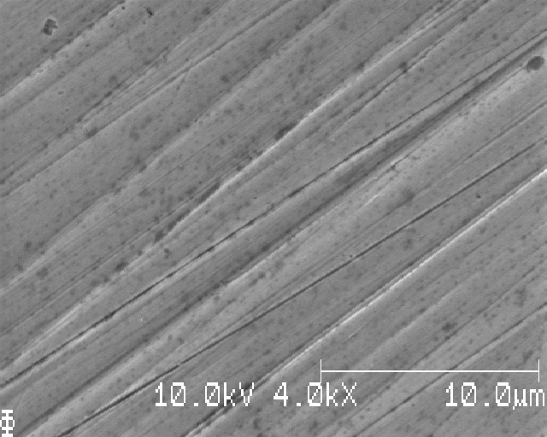
S17_t1800_C0010
Mechanical polishing, even to 0.25 microns diamond slurry, results in ‘grinding lines’. If electropolishing is performed, these lines mostly vanish

Slide 32
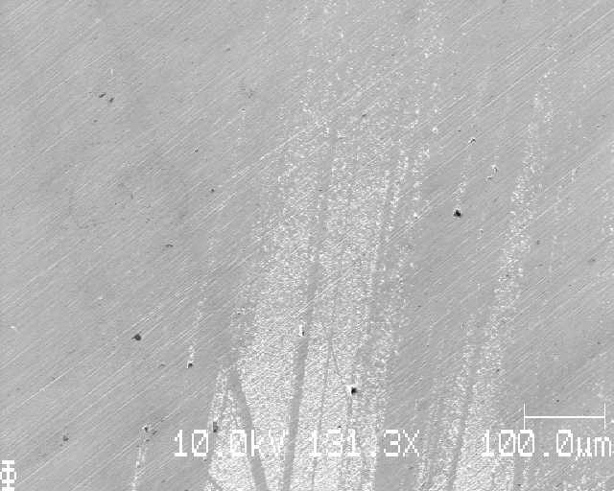
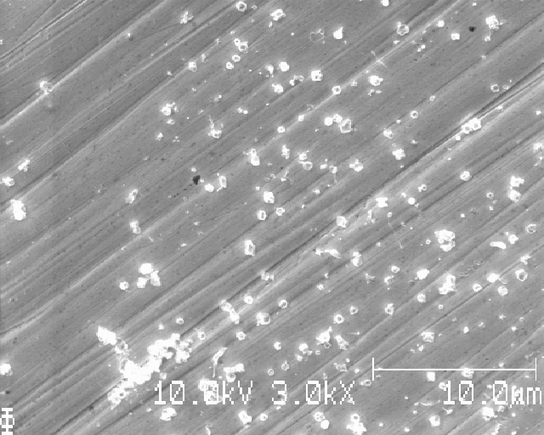
S17_t1800_C0010
Very uneven Li appearing in stripes (not in the direction of the grinding marks)

Slide 33
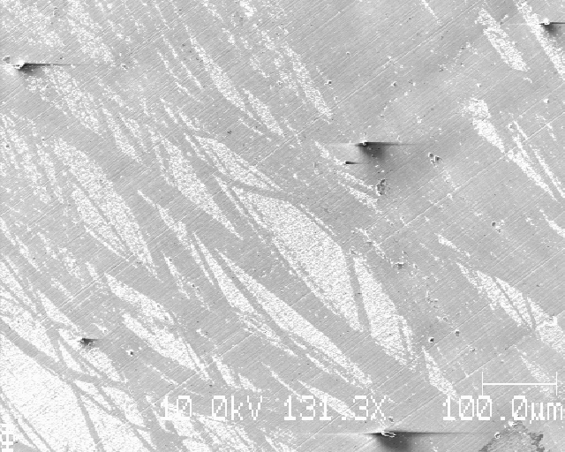
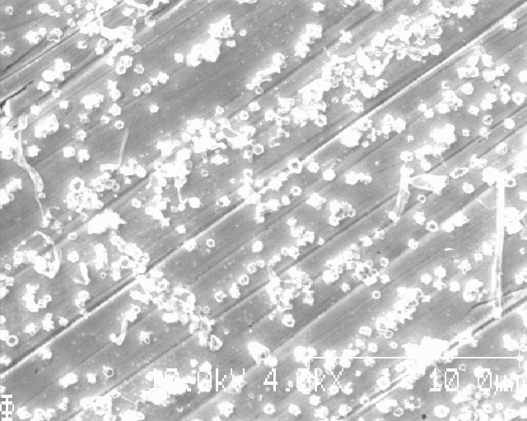
S17_t1800_C0010
Very uneven Li appearing in stripes (not in the direction of the grinding marks)

Slide 34
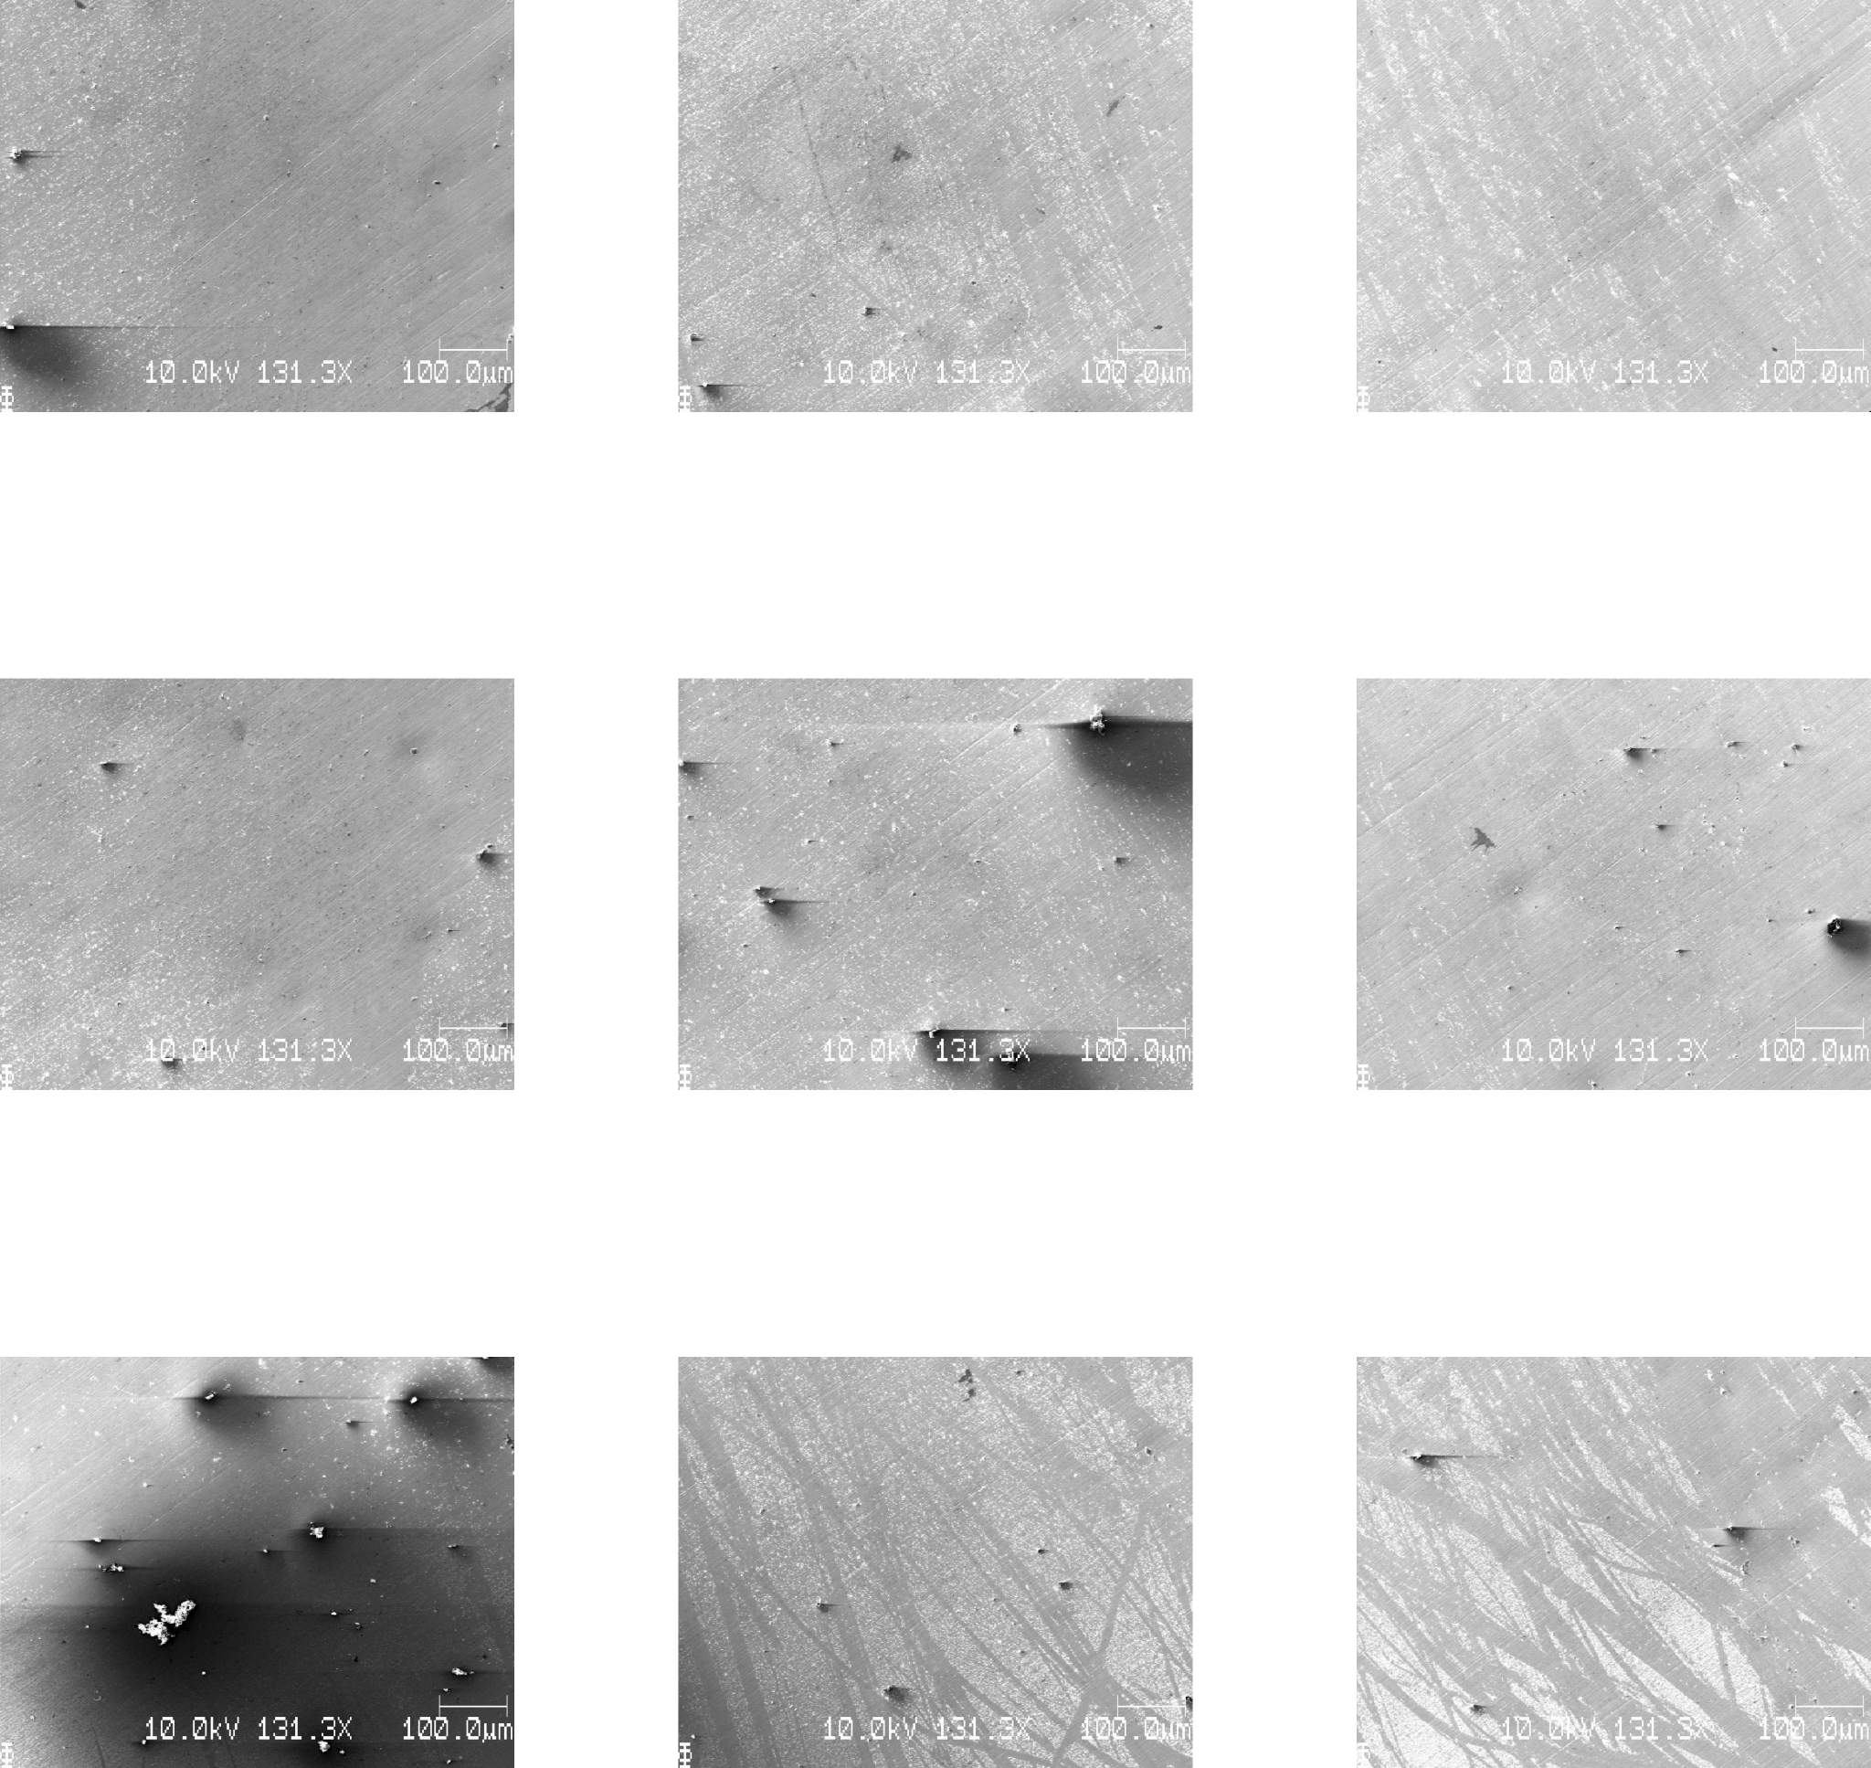
S17_t1800_C0010
dx=dy=1000mu

Slide 35
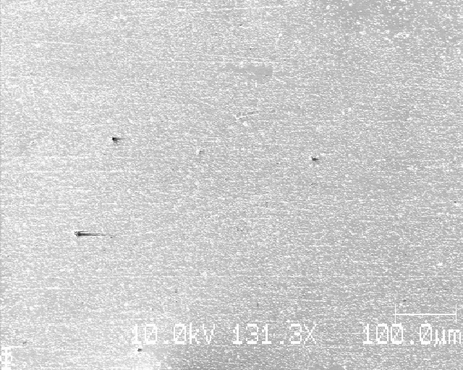
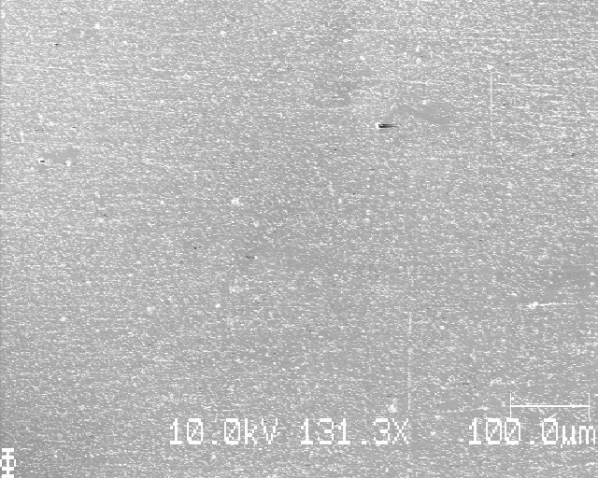
S18_t1800_C0010
Very even Li deposition at several places

Slide 36
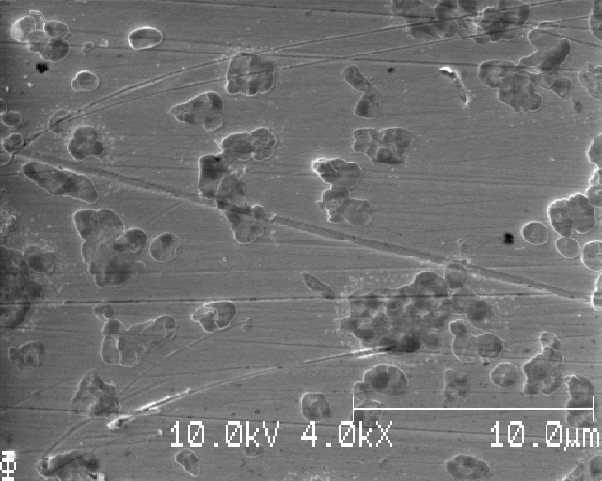
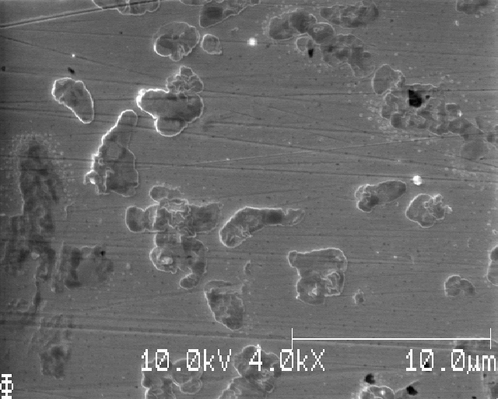
S18_t1800_C0010
Some tiny Li(?) can be observed around Li particles

Slide 37
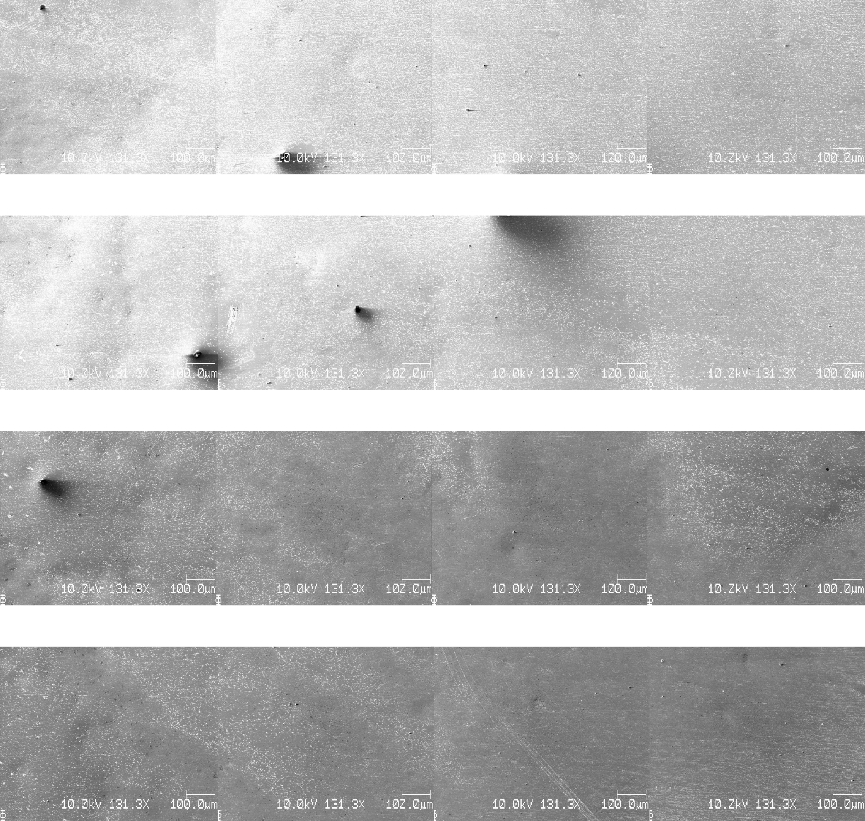
S18_t1800_C0010
dx=dy=750mu
Changed the contrast from image 8 to 9

Slide 38
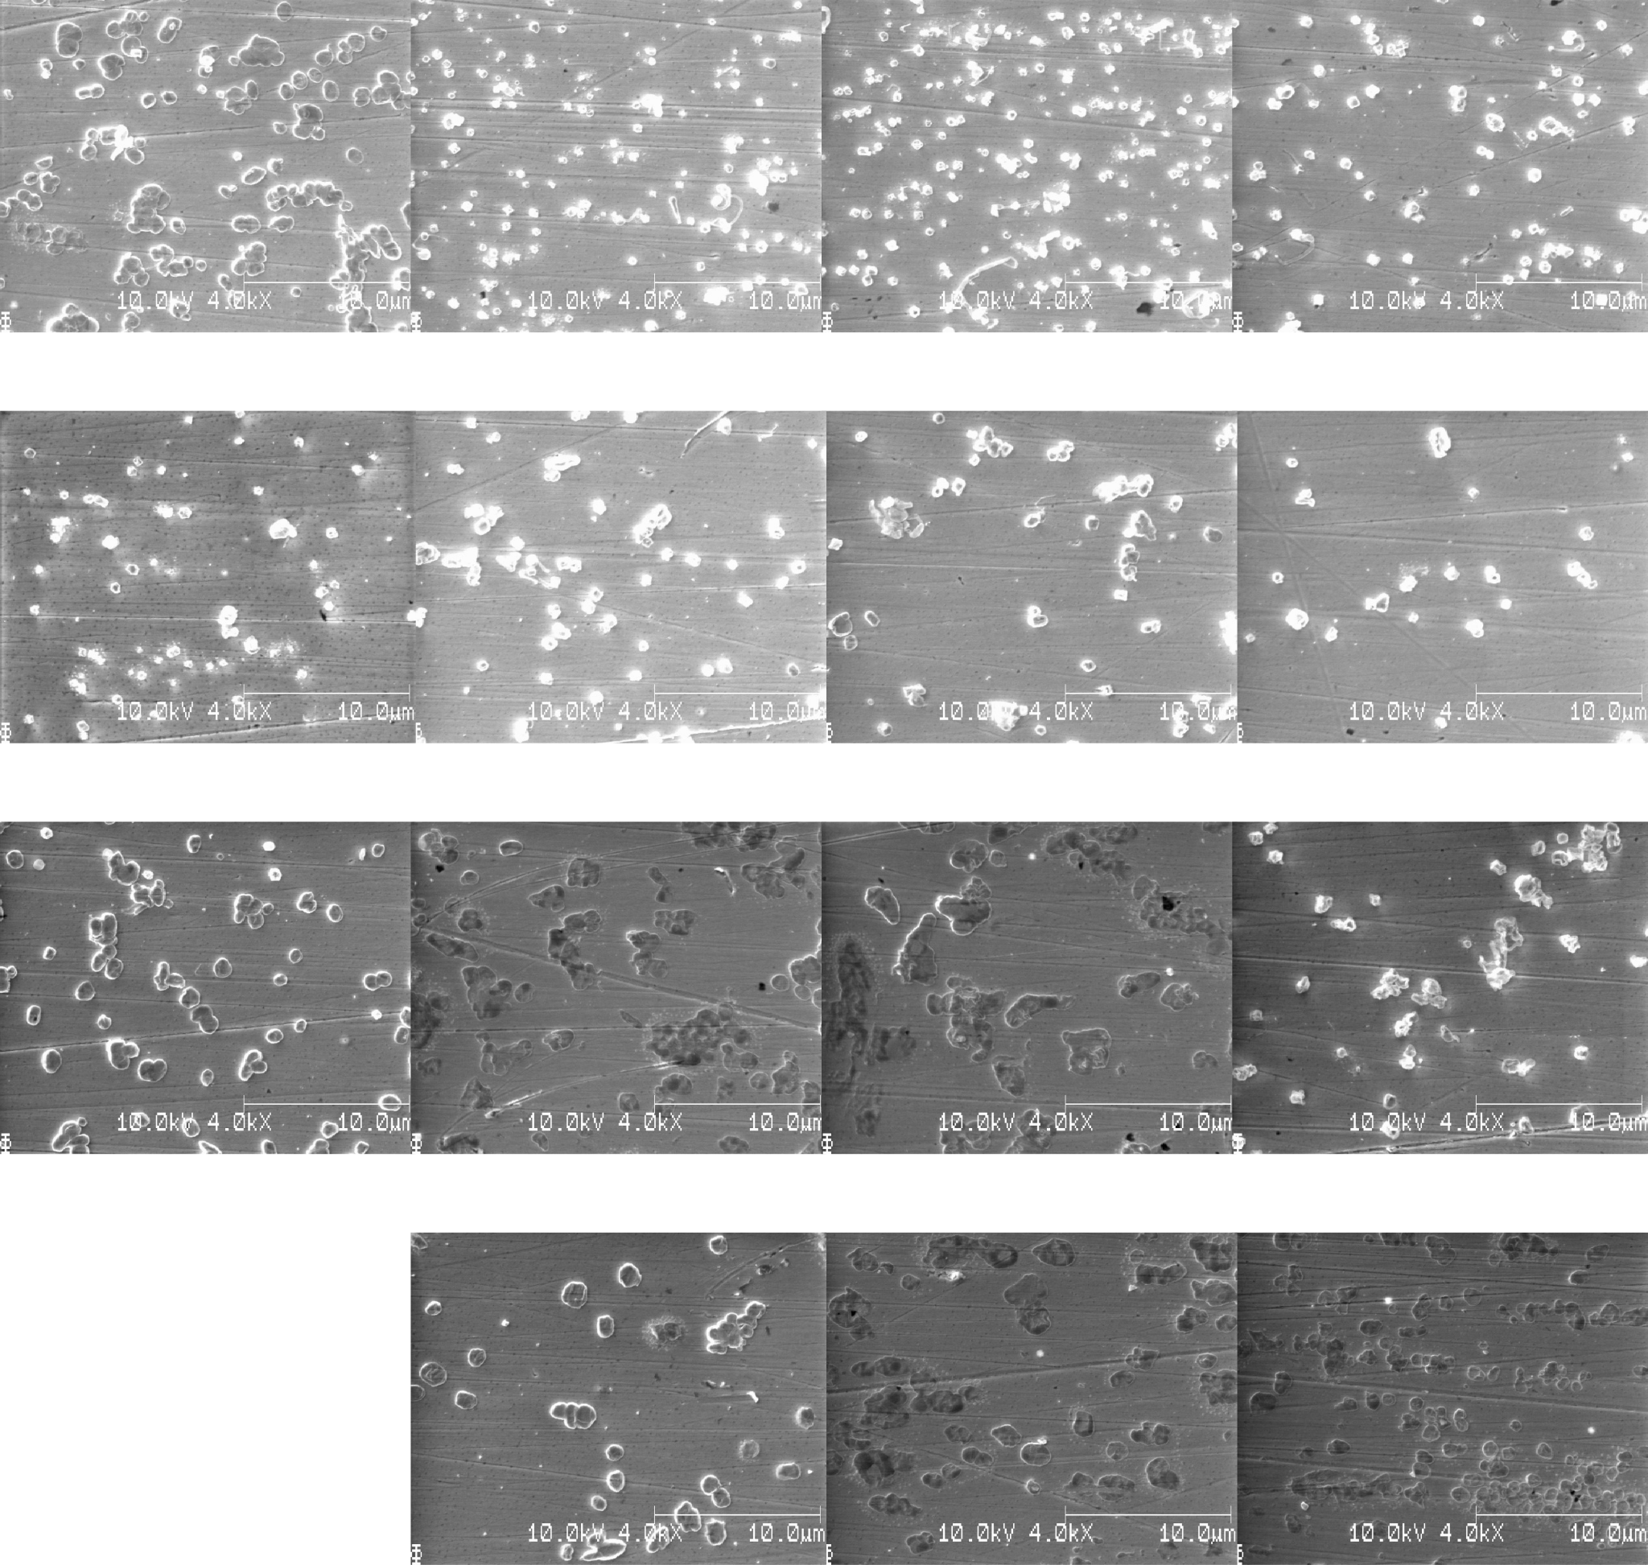
S18_t1800_C0010
dx=dy=750mu
Zoom
Changed the contrast from image 8 to 9

Slide 39
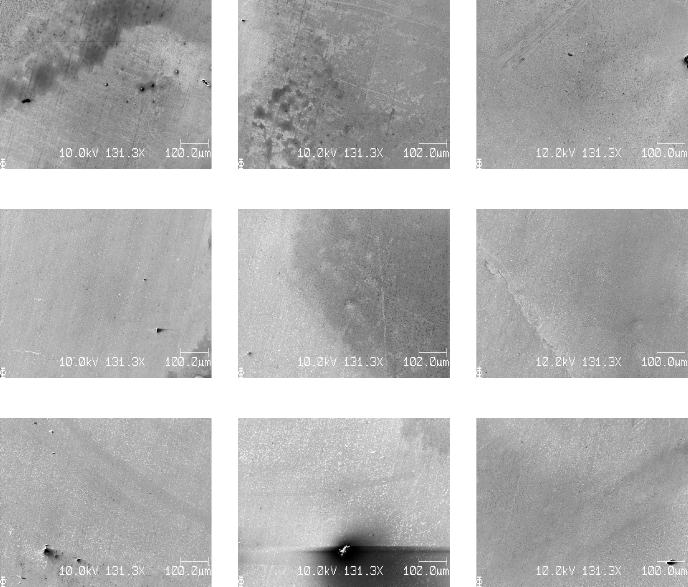
S19_t1800_C0010
Very uneven Li
dx=dy=1500mu

Slide 40
SEM-04
S20_t1800_C0010 (plating/stripping using C0010, final deposition using C0010)
S21_t1800_C0000 (plating/stripping using C0010, no final deposition)
S22_t0000_C0050 (LFP, no passivation, direct deposition)
S23_t0000_C0050 (LFP, no passivation, direct deposition)
Why measure? To investigate…
Ways of achieving more uniform Li deposition
Cycling of plating and stripping before deposition and using LFP as cathode material

Slide 41
S20_t1800_C0010 (plating/stripping, deposition)
No clear 5 mm Li disk of deposition, looks like Li over much larger area

Slide 42
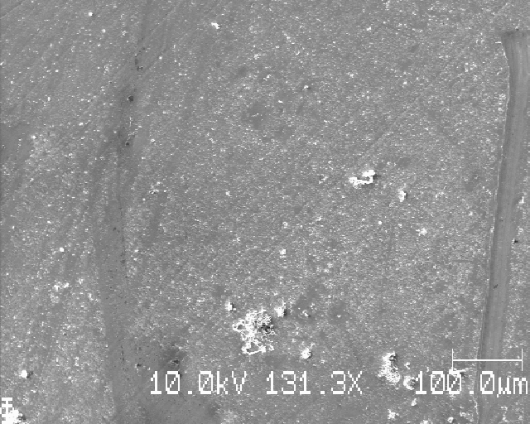

S20_t1800_C0010 (plating/stripping, deposition)
Large variation in sizes and shapes of Li

Slide 43


S20_t1800_C0010 (plating/stripping, deposition)
Large variation in sizes and shapes of Li

Slide 44



S21_t1800_C0000 (plating/stripping, no final deposition)
See unevenly deposited Li

Slide 45


S21_t1800_C0000 (plating/stripping, no final deposition)
For SEM images of stripped Li, see: https://static-content.springer.com/esm/art%3A10.1038%2Fs41557-018-0203-8/MediaObjects/41557_2018_203_MOESM1_ESM.pdf
Some very small Li looks like Li that has been stripped

Slide 46

S22_t0000_C0050 (LFP, no passivation, direct deposition)
Small black ‘holes’(?) observed in the Cu

Slide 47



S22_t0000_C0050 (LFP, no passivation, direct deposition)
Uneven Li, globally

Slide 48


S22_t0000_C0050 (LFP, no passivation, direct deposition)
Uneven Li, globally and locally

Slide 49


S23_t0000_C0050 (LFP, no passivation, direct deposition)
Small black spots (‘holes’?) here too

Slide 50






S23_t0000_C0050 (LFP, no passivation, direct deposition)
More even deposition

Slide 51
SEM-05
S26_t1800_C0010 (12 mm diameter Li)
S27_t1800_C0010 (12 mm diameter Li)
S28_t1800_C0010 (12 mm diameter Li, Li “polished’’)
S29_t1800_C0010 (12 mm diameter Li, Li “polished’’)
Why measure? To investigate…
If a larger Li (12 mm diameter) and a polished Li (surface scraped clear using a scalpel) leads to more uniform Li deposition

Slide 52
S26_t1800_C0010 (12 mm diameter Li)
Looks pretty good! However, still some unevenness (but much smaller variations compared to the 5 mm Li)
Given that you take 4x4 images and average them, I’d say that the observed variations are fine (especially if you allow some slight deviations from the 4x4 grid-points)

Slide 53

S26_t1800_C0010 (12 mm diameter Li)
dx=dy=1000mu

Slide 54
S26_t1800_C0010 (12 mm diameter Li)
If allowed to take images slightly off the exact grid-coordinates (as in <100 mu away) we get the images in the following slides (called ‘new’)

Slide 55
S26_t1800_C0010 (12 mm diameter Li)
Old

Slide 56

S26_t1800_C0010 (12 mm diameter Li)
New

Slide 57

S26_t1800_C0010 (12 mm diameter Li)
Old
zoom

Slide 58

S26_t1800_C0010 (12 mm diameter Li)
New
zoom

Slide 59
S26_t1800_C0010 (12 mm diameter Li)
A larger Li (12mm in diameter) seems to induce much more even Li deposition than a smaller (5 mm in diameter) Li
Note that the different size of Li changes the pressure in the cell!
By taking SEM images in a grid, you cover a large area and get plenty of particles for good statistics. (Even if there are local variations in Li deposition between the grid-points, overall the averaging should yield good results).
By also allowing slight deviations (by, say <100 micrometer in x and y) from the grid-coordinates for each image, you can avoid obvious non-representative areas and get a much more homogenous and representative sampling of Li.

Slide 60






S27_t1800_C0010 (12 mm diameter Li)
Pretty even Li (but seemingly very little); Li looks corroded (all of it) - curious

Slide 61


S28_t1800_C0010 (12 mm diameter Li, Li ‘’polished’’)
So-and-so evenness
Polishing did not give rise to obvious preferred Li deposition (that is good)

Slide 62


S28_t1800_C0010 (12 mm diameter Li, Li ‘’polished’’)
Very few corroded Li particles - only nice crystalline particles on the sample

Slide 63


S29_t1800_C0010 (12 mm diameter Li, Li ‘’polished’’)
So-and-so evenness

Slide 64


S29_t1800_C0010 (12 mm diameter Li, Li ‘’polished’’)
Different morphologies compared to S28 (not only nice crystalline particles)

Slide 65
Summary: polishing
Mechanical polishing results in ‘grinding’-marks, even when polished to 0.25 microns diamond slurry (S17)
Electropolishing after mechanical polishing to P4000 grit paper removes the grinding-marks (S07, S08, S09, …)
Electropolishing makes the image analysis easier

Slide 66
Summary: deposited Li
Smallest deposited capacity where Li was observed: 3 muAh/cm² (S07)
Long needle-like structures first observed for: 10 muAh/cm² (S13)
Observation was made of:
‘’Worms’’ (S07, S09, S12)
‘’Halos’’ around Li particles (S08, )
Highly uneven Li deposition (S08, S12, S17, S19, S21, S22)
Even Li deposition over the whole sample (S18, 26)
Corroded Li (most samples had some corrosion)
Unusual Li(?) structures (S16, S20)
Plating/stripping before deposition seems to be unfavorable as it leaves stuff on the surface
Use of a cathode material could be considered
Li of similar size to the Cu seems to improve the evenness of the deposition

Slide 67


Summary: SEM image acquisition and analysis
Note on number of particles per image:
The image below has over 100 particles (analyzed by ImageJ to have 120 particles (neglecting analyzed particles with very small areas))
I propose the 4x4 grid sampling (centered on the Li deposition) with, say, 1000 micrometer spacing between images in the x- and y- direction
Take images with magnification such that about 70 to 100 particles (think 10 particles in x and 10 particles in y)) are visible per image
This would give sufficient resolution per image
Allow a slight offset for the images (say < 100 micrometer)
If an image on a certain grid point contains unusually few (or many) particles, or otherwise include unrepresentative elements (wierd structures, cracks in the Cu, …) then allow the SEM image to be taken in a close vicinity where the nuclei distribution is more representative for that area
16 images with ~100 particles each gives more than good enough statistics per sample
Notes:
Note on number of particles per image:

Slide 68


Summary: SEM image acquisition and analysis
Example of SEM images with a reasonable number of particles

Slide 69
Summary: reproducibility
Reproducibility issues remain
A few samples have shown good, evenly Li distribution
Most samples have had one or more of these problems:
Uneven Li distribution (locally) – if this is not too bad this can be ignored
Uneven Li distribution (globally)
Different Li morphologies
Different amount of corrosion of the Li particles
Uneven or insufficient washing after deposition
(This is probably solved using the most recent washing method)

Slide 70
Ideas for improving reproducibility
Different washing procedure after electropolishing the Cu
Maybe include another solvent
Use polished Li with same diameter (or slightly smaller) as Cu
Larger Li diameter for more even pressure (compared to 5 mm)
Removal of the oxide layer on the Li removes that as a factor
Polish the metal cell parts that are in contact with the Li, Cu, or electrolyte before each cycling
To remove any stuff on the surfaces, to maybe reduce corrosion of the deposited Li

Slide 71
Next steps
One path:
Solve the reproducibility problem
Eliminate factors until the Li deposition is regular “enough” between cells
Cycle cells with:
e.g. 2 different levels of passivation (t = 12 s and 1800 s)
e.g. 5 different amounts of capacities C of deposited Li per degree of passivation
Take SEM images in a 4x4 grid for each sample
Perform image analysis to obtain:
areal nuclei density N(t, C)
radial distribution r(n)

